Slide 1

Digital KYC: Reducing Drop-off & Lifting Conversion
A structured solution to enhance the bank's Digital KYC process, addressing high customer drop-offs and rejection rates.

Slide 2

Executive Summary
The bank's new Digital KYC process faces high drop-offs and rejections due to issues like improper document scanning, slow server responses, and unclear next steps.
Problem
Solution
Goal
High customer drop-offs and rejection rates in Digital KYC.
UX improvements, technical enhancements, process changes, and automated validations.
Reduce abandonment, shorten TAT, and improve conversion.

Slide 3




Problem Background: KYC Failure Points
Customers face multiple failure points during the Digital KYC process, from document selection to final approval.
35%
25%
15%
Scan Document
Upload Document
Select Document
Highest failure rate due to image quality.
Issues with image size and internet stability.
Confusion over valid ID types.
15%
10%
KYC Check
KYC Approval
OCR and data mismatch problems.
Photograph mismatch or expired documents.

Slide 4

Root Cause Analysis: Why Failures Occur
Document Selection (15%)
Confusion between valid ID types.
Lack of upfront instructions.
Document Scan (35%)
Blurry images, poor lighting, glare.
No positioning guidelines.
Document Upload (25%)
Large image size, unstable internet.
Slow server response (>20 sec).

Slide 5
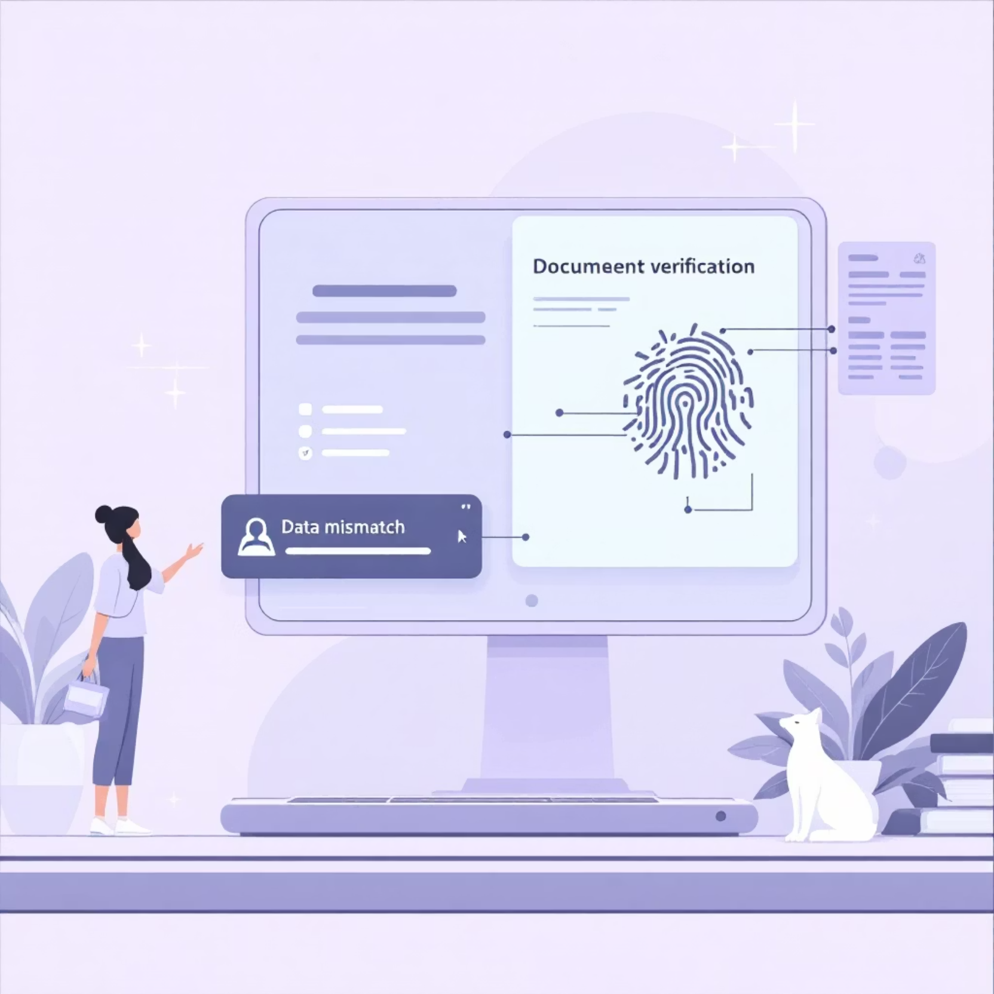
Root Cause Analysis: Verification & Approval
KYC Check (15%)
OCR unable to extract key fields.
MRZ/Barcode not readable.
Data mismatch with customer profile.
KYC Approval (10%)
Photograph mismatch with selfie.
Document expired (e.g., Passport).
Duplicate KYC in existing database.

Slide 6



Proposed Solution: UI/UX & Technical Improvements
UI/UX Enhancements
Technical Optimizations
Step-wise progress bar.
Local image compression.
Real-time blur detection alerts.
Auto-enhancement (brightness, sharpness).
Document-specific guidance.
Pre-scan validation for glare/blur.
Countdown timer for uploads.
Parallel request handling.
Server-side asynchronous OCR.

Slide 7




Proposed Solution: Business & Process Improvements
Mandatory Documents
Auto-Approval
Smart Retry Logic
Restrict to only essential documents (PAN + Aadhaar) to simplify the process.
Implement auto-approval for low-risk KYC cases, speeding up processing.
Allow 3 attempts per stage, storing reasons for failure to improve future attempts.

Slide 8







System Architecture Overview
Client-Side Preprocessing
Web App UI Layer
API Gateway
Analytics Dashboard
KYC Validation Engine
Notification Engine
KYC Database (Encrypted)

Slide 9
Expected Impact & Implementation Roadmap
Expected Impact
Implementation Roadmap
Scan-stage failure: 35% to 15%.
01
Upload failure: 25% to <10%.
UX & Document Redesign
KYC completion time: 2.5 min to <1 min.
Overall KYC conversion: ~30–40% increase.
02
Preprocessing Engine
03
Backend engine
04
Analytics Dashboard
05
Pilot Test & Rollout

Slide 10

Conclusion: Enhanced KYC for Higher Conversion
The redesigned Digital KYC process will significantly improve customer satisfaction and conversion rates.
Better User Guidance
Stronger Validation
Clear instructions and real-time feedback.
Automated checks reduce errors.
Technical Optimization
Faster processing and improved reliability.

